Slide 1

Fayllar

Slide 2
Fayl bilan ishlash
PHPda faylni ochish fopen() funksiyasi orqali amalga oshiriladi. Sintaksisi:
fopen( string $filename, string $mode, bool $use_include_path = false, resource $context = ?) : resource
Faylni yopish uchun fclose() funksiyasi ishlatiladi: fclose( resource $stream) : bool
Rejimlar:
r – faylni faqat o'qish uchun ochish, ko'rsatkich fayl boshiga o'tkaziladi;
r+ – faylni o'qish va yozish uchun ochish, ko'rsatkich fayl boshiga o'tkaziladi;
w – faylni faqat yozish uchun ochish, ko'rsatkich fayl boshiga o'tkaziladi va fayl tozalanadi;
w+ – faylni o'qish va yozish uchun ochish, ko'rsatkich fayl boshiga o'tkaziladi va fayl tozalanadi;
a – faylni faqat yozish uchun ochish, ko'rsatkich fayl oxiriga o'tkaziladi;
a+ – faylni o'qish va yozish uchun ochish, yozishda ko'rsatkich fayl oxiriga o'tkaziladi;
x – w kabi ishlaydi, faqat fayl mavjud bo'lsa E_WARNING xatoligi yuzaga keladi;
x+ – x kabi ishlaydi, faqat fayl o'qish va yozish uchun ochiladi.

Slide 3
Fayl bilan ishlash
1. Faylga yozish - fwrite( resource $handle, string $string, int $length = ?) : int
2. Fayldan o'qish - fread( resource $stream, int $length) : string|false
3. Fayldan belgi o'qish - fgetc( resource $stream) : string|false
4. Fayldan qator o'qish - fgets( resource $handle, int $length = ?) : string|false
5. Fayldan formatli o'qish - fscanf( resource $stream, string $format, mixed &...$vars) : array|int|false|null
6. Fayl o'lchamini olish - filesize( string $filename) : int|false
7. Fayl oxiriga yetganligini tekshirish - feof( resource $stream) : bool
8. Fayl yoki katalog mavjudligini tekshirish - file_exists( string $filename) : bool
9. Direktoriya yaratish - mkdir( string $pathname, int $mode = 0777, bool $recursive = false, resource $context = ?) : bool
10. Direktoriyani o'chirish - rmdir( string $dirname, resource $context = ?) : bool
11. Faylni o'chirish - unlink( string $filename, resource $context = ?) : bool

Slide 4
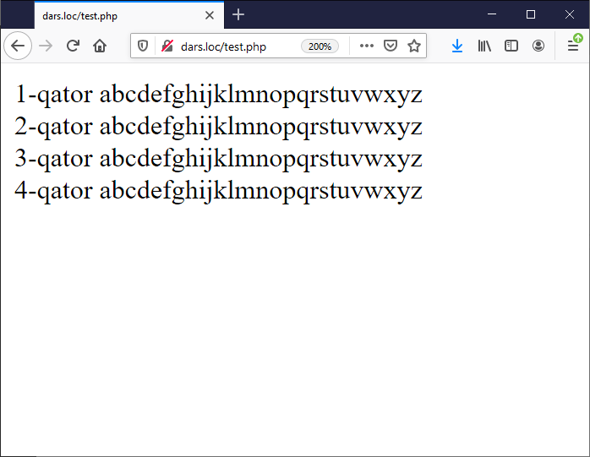
Fayl bilan ishlash
<?php
$f = fopen("file.txt", "r");
if (!$f) {
echo ("Fаyl оchish хаtоligi");
} else {
while (!feof($f)) {
$text = fgets($f);
print $text . "<br/>";
}
}
fclose($f);

Slide 5
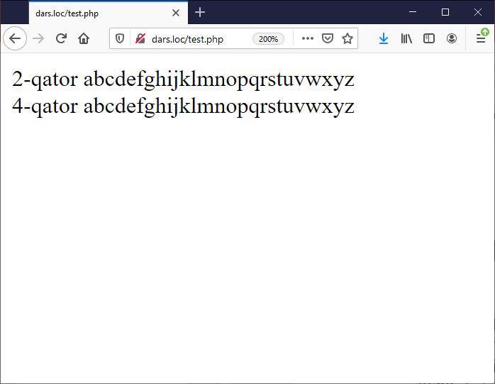
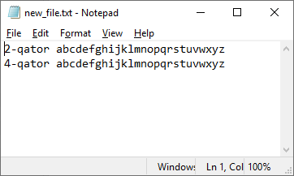
Fayl bilan ishlash
<?php
$f = fopen("file.txt", "r");
$g = fopen("new_file.txt", "w");
if (!$f && !$g) {
echo ("Fаyl оchish хаtоligi");
} else {
while (!feof($f)) {
$text = fgets($f);
if ((int)$text[0] % 2 == 0) {
fwrite($g, $text);
print $text . "<br/>";
}
}
}
fclose($f);
fclose($g);

Slide 6
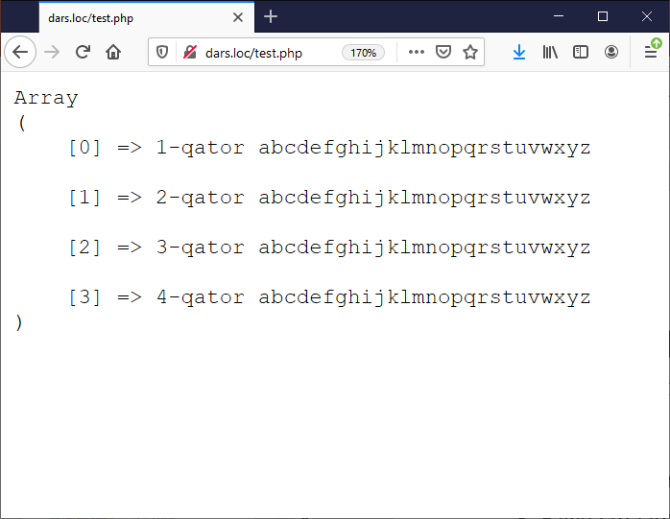
Fayl bilan ishlash
1. Faylni o'qish va massiv hosil qilish - file( string $filename, int $flags = 0, resource $context = ?) : array
2. Faylni satrga o'qish - file_get_contents( string $filename, bool $use_include_path = false, resource $context = ?, int $offset = 0, int $maxlen = ?) : string|false
3. Faylga ma'lumot yozish - file_put_contents( string $filename, mixed $data, int $flags = 0, resource $context = ?) : int
<?php
$f = file("file.txt");
print "<pre>";
print_r($f);

Slide 7
Fayl bilan ishlash
basename – ko'rsatilgan manzildagi oxirgi komponentni qaytaradi
<?php echo "1) ".basename("/etc/sudoers.d", ".d").PHP_EOL; echo "2) ".basename("/etc/sudoers.d").PHP_EOL; echo "3) ".basename("/etc/passwd").PHP_EOL; echo "4) ".basename("/etc/").PHP_EOL; echo "5) ".basename(".").PHP_EOL; echo "6) ".basename("/"); ?>
1) sudoers
2) sudoers.d
3) passwd
4) etc
5) .
6)

Slide 8
Sehrli konstantalar (magic constants)
__LINE__ - fayldagi joriy satrning nomeri
__FILE__ - joriy faylning to'liq manzili va nomi
__DIR__ - fayl direktoriyasi
Barcha sehrli konstantalar: https://www.php.net/manual/en/language.constants.magic.php

Slide 9
Supergloballar - $_FILES
Fayllarni yuklashning qo'shimcha sozlamalari php.ini sozlamalar faylidagi file_uploads, upload_max_filesize, upload_tmp_dir, post_max_size и max_input_time direktivalari orqali boshqariladi.
$_FILES global massivi userfile nomli forma elementi uchun quyidagicha bo'ladi:
$_FILES['userfile']['name'] – faylning mijoz kompyuteridagi original nomi.
$_FILES['userfile']['type'] – brauzer taqdim etsa faylning mime-tipi. Masalan, "image/gif".
$_FILES['userfile']['size'] – faylning baytdagi o'lchami.
$_FILES['userfile']['tmp_name'] – faylning serverda saqlangan vaqtincha nomi.
$_FILES['userfile']['error'] – faylni yuklash jarayonidagi xatolik kodi.
move_uploaded_file( string $from, string $to) : bool – faylni ko'chirish uchun funksiya

Slide 10
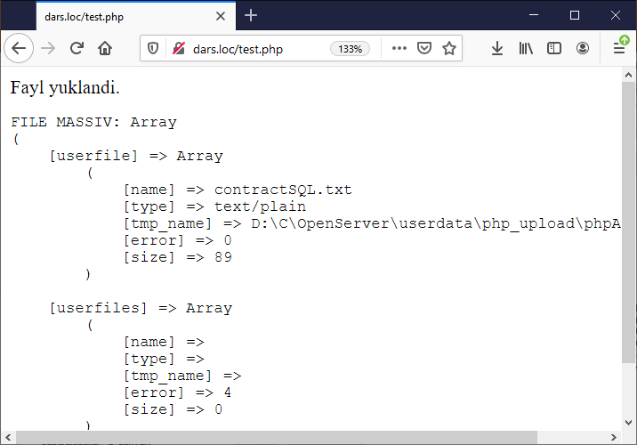
Supergloballar - $_FILES
<form method="POST" action="/test.php" enctype="multipart/form-data">
<input type="file" name="userfile">
<input type="file" name="userfiles[]" multiple> <input type="submit" value="OK">
</form>
<?php
$uploaddir = '/files/';
$uploadfile = __DIR__ . $uploaddir . basename($_FILES['userfile']['name']);
if (move_uploaded_file($_FILES['userfile']['tmp_name'], $uploadfile)) {
echo "Fayl yuklandi.\n";
} else {
echo "Fayl yuklanmadi!\n";
} echo '<pre>FILE MASSIV: ';
print_r($_FILES);

Slide 11
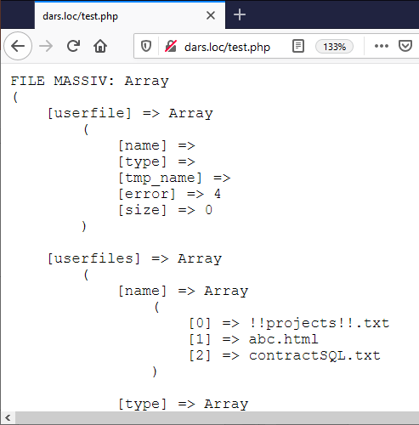
Supergloballar - $_FILES
<form method="POST" action="/test.php" enctype="multipart/form-data">
<input type="file" name="userfile">
<input type="file" name="userfiles[]" multiple> <input type="submit" value="OK">
</form>
<?php
$uploaddir = '/files/';
foreach ($_FILES["userfiles"]["error"] as $key => $error) {
if ($error == UPLOAD_ERR_OK) {
$tmp_name = $_FILES["userfiles"]["tmp_name"][$key];
$name = basename($_FILES["userfiles"]["name"][$key]);
$dest_name = __DIR__ . $uploaddir . $name;
move_uploaded_file($tmp_name, $dest_name);
}
} echo '<pre>FILE MASSIV: ';
print_r($_FILES);

Slide 12
Katalogdan qidirish
glob – shablonga mos keluvchi barcha manzillarni qaytaradi.
glob( string $pattern, int $flags = 0) : array|false
Shablon:
* - nol yoki undan ko'p belgilar miqdoriga mos keladi
? –bitta ixtiyoriy simvolga mos keladi
[...] – guruhdagi bitta simvolga mos keladi. Agar birinchi simvol ! bo'lsa, guruhga kirmagan ixtiyoriy simvolga mos keladi
\ - simvolni ekranlashtiradi
<?php
function outputFiles($path)
{
// Katalog mavjudligini tekshirish
if (file_exists($path) && is_dir($path)) {
// Katalogdagi fayllarni qidirish
$files = glob($path . "/*");
if (count($files) > 0) {
foreach ($files as $file) {
if (is_file("$file")) {
echo basename($file) . " " . filesize($file) . "<br>";
} else if (is_dir("$file")) {
// Agar katalog bo'lsa rekursiv ishlatish
outputFiles("$file");
}
}
} else {
echo "ERROR: No such file found in the directory.";
}
} else {
echo "ERROR: The directory does not exist.";
}
}
outputFiles("css");

Slide 13
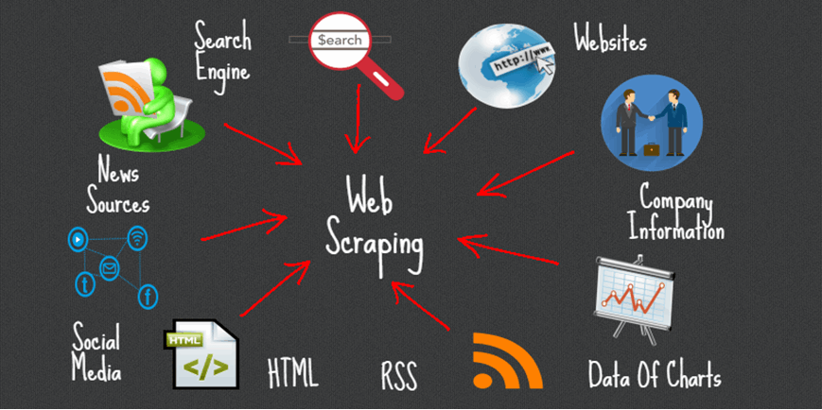
Web scraping

Slide 14
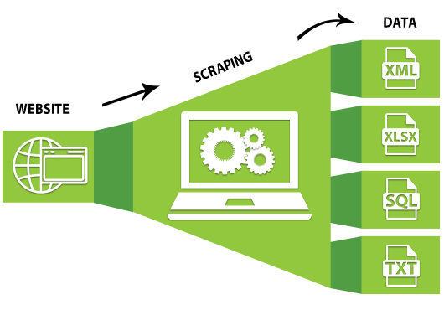
Web scraping

Slide 15
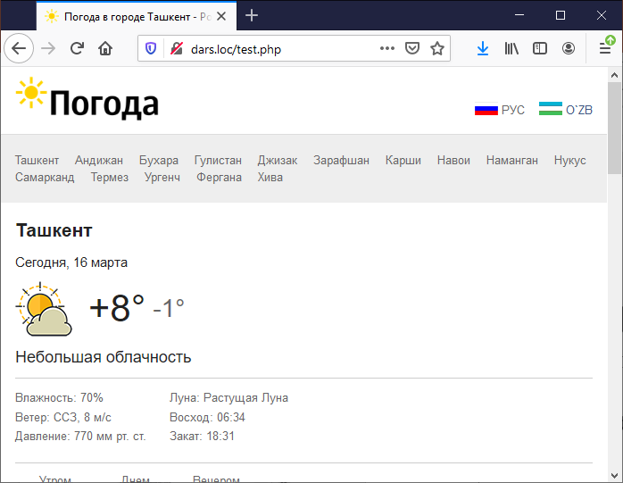
Fayl bilan ishlash
<?php
$f = file_get_contents("http://pogoda.uz");
echo $f;

Slide 16
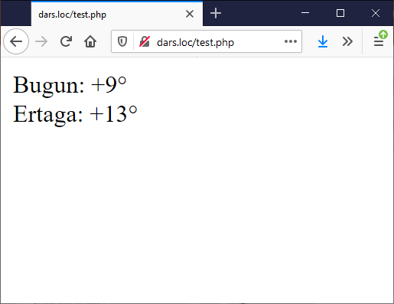
Web scraping
<?php
$f = file_get_contents("http://pogoda.uz");
$a = strpos($f, "current-forecast");
$f = substr($f, $a);
$a = strpos($f, "<strong>");
$f = substr($f, $a);
$a = strpos($f, "</strong>");
$gradus = substr($f, 8, $a - 8);
$f = substr($f, $a);
$a = strpos($f, "Завтра");
$f = substr($f, $a);
$a = strpos($f, "forecast-day");
$f = substr($f, $a);
$a = strpos($f, "</span>");
$gradus_ertaga = substr($f, 14, $a - 14);
echo "Bugun: $gradus<br />Ertaga: $gradus_ertaga";

Slide 17
Savollar?

